Slide 1

332:479 Concepts in VLSI
Design
Lecture 9
Logical Effort
David Harris
Harvey Mudd College
Spring 2004

Slide 2
Outline
Introduction
Delay in a Logic Gate
Multistage Logic Networks
Choosing the Best Number of Stages
Example
Summary
Material from: CMOS VLSI Design,
by Weste and Harris, Addison-Wesley, 2005

Slide 3

Introduction
Chip designers face a bewildering array of choices
  What is the best circuit topology for a function?
  How many stages of logic give least delay?
  How wide should the transistors be?
Logical effort is a method to make these decisions
  Uses a simple model of delay
  Allows back-of-the-envelope calculations
  Helps make rapid comparisons between alternatives
  Emphasizes remarkable symmetries

Slide 4
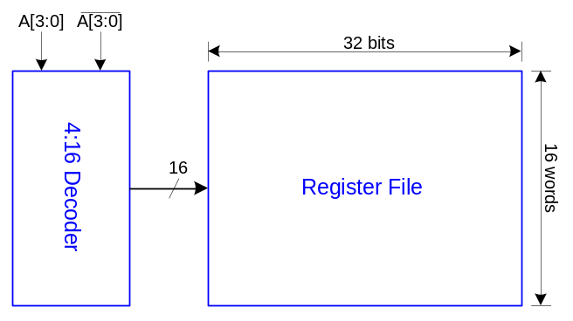
Example
Ben Bitdiddle is the memory designer for the Motoroil 68W86, an embedded automotive processor. Help Ben design the decoder for a register file.
Decoder specifications:
  16 word register file
  Each word is 32 bits wide
  Each bit presents load of 3 unit-sized transistors
  True and complementary address inputs A[3:0]
  Each input may drive 10 unit-sized transistors
Ben needs to decide:
  How many stages to use?
  How large should each gate be?
  How fast can decoder operate?

Slide 5
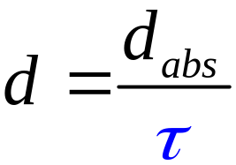
Delay in a Logic Gate
Express delays in process-independent unit
τ =3RC
≈ 12 ps in 180 nm process
40 ps in 0.6 μm process

Slide 6
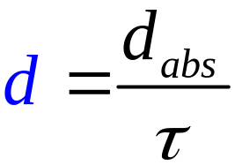

Delay in a Logic Gate
Express delays in process-independent unit
Delay has two components

Slide 7
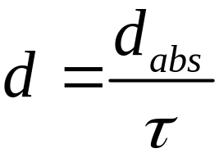

Delay in a Logic Gate
Express delays in process-independent unit
Delay has two components
Effort delay f = gh (a.k.a. stage effort)
  Again has two components

Slide 8

Delay in a Logic Gate
Express delays in process-independent unit
Delay has two components
Effort delay f = gh (a.k.a. stage effort)
  Again has two components
g: logical effort
  Measures relative ability of gate to deliver current
  g ≡ 1 for inverter

Slide 9
Delay in a Logic Gate
Express delays in process-independent unit
Delay has two components
Effort delay f = gh (a.k.a. stage effort)
  Again has two components
h: electrical effort = C_{out} / C_{in}
  Ratio of output to input capacitance
  Sometimes called fanout

Slide 10

Delay in a Logic Gate
Express delays in process-independent unit
Delay has two components
Parasitic delay p
  Represents delay of gate driving no load
  Set by internal parasitic capacitance

Slide 11
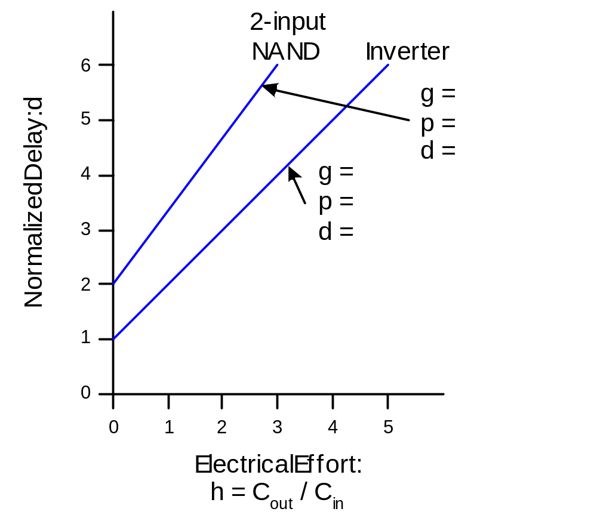
Delay Plots
d = f + p
  = gh + p

Slide 12
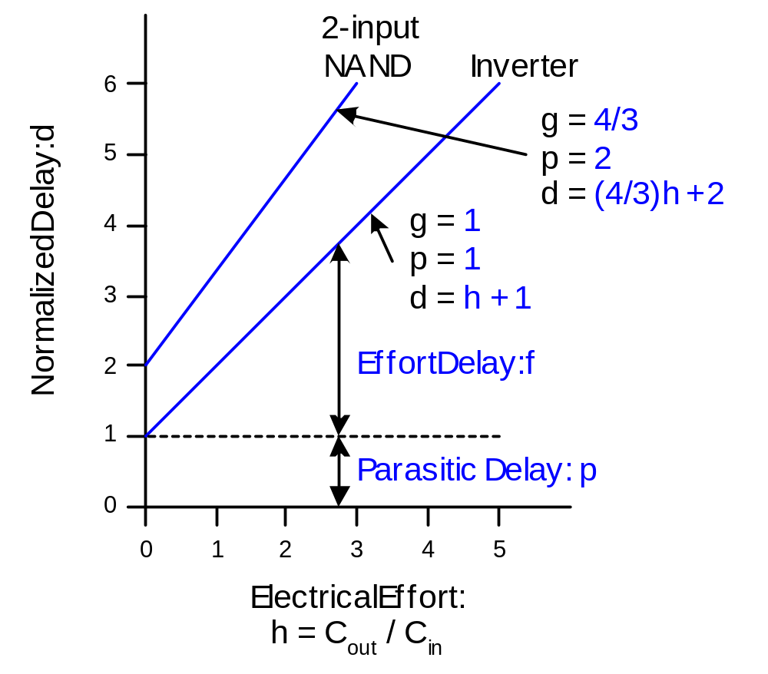
Delay Plots
d = f + p
  = gh + p
What about
NOR2?

Slide 13
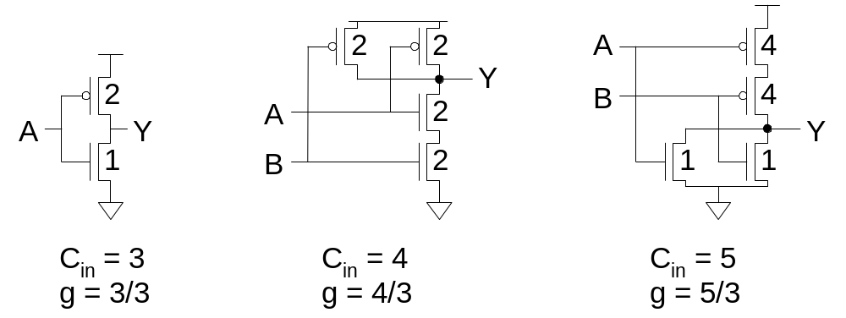
Computing Logical Effort
DEF: Logical effort is the ratio of the input capacitance of a gate to the input capacitance of an inverter delivering the same output current.
Measure from delay vs. fanout plots
Or estimate by counting transistor widths

Slide 14
Catalog of Gates
Logical effort of common gates
Gate type | Number of inputs
 | 1 | 2 | 3 | 4 | n
Inverter | 1
NAND |  | 4/3 | 5/3 | 6/3 | (n+2)/3
NOR |  | 5/3 | 7/3 | 9/3 | (2n+1)/3
Tristate / mux | 2 | 2 | 2 | 2 | 2
XOR, XNOR |  | 4, 4 | 6, 12, 6 | 8, 16, 16, 8

Slide 15
Catalog of Gates
Parasitic delay of common gates
  In multiples of p_{inv} (≈1)
Gate type | Number of inputs
 | 1 | 2 | 3 | 4 | n
Inverter | 1
NAND |  | 2 | 3 | 4 | n
NOR |  | 2 | 3 | 4 | n
Tristate / mux | 2 | 4 | 6 | 8 | 2n
XOR, XNOR |  | 4 | 6 | 8

Slide 16
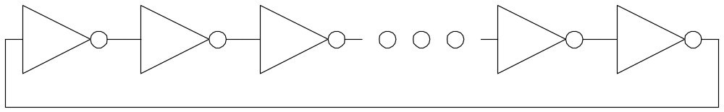
Example: Ring Oscillator
Estimate the frequency of an N-stage ring oscillator
Logical Effort: g =
Electrical Effort: h =
Parasitic Delay: p =
Stage Delay: d =
Frequency: f_{osc} =

Slide 17
Example: Ring Oscillator
Estimate the frequency of an N-stage ring oscillator
Logical Effort: g = 1
Electrical Effort: h = 1
Parasitic Delay: p = 1
Stage Delay: d = 2
Frequency: f_{osc} = 1/(2*N*d) = 1/4N
31 stage ring oscillator in 0.6 μm process has frequency of ~ 200 MHz

Slide 18
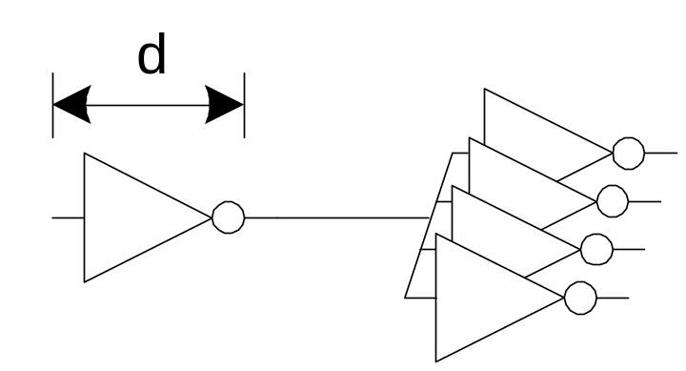
Example: FO4 Inverter
Estimate the delay of a fanout-of-4 (FO4) inverter
Logical Effort: g =
Electrical Effort: h =
Parasitic Delay: p =
Stage Delay: d =

Slide 19
Example: FO4 Inverter
Estimate the delay of a fanout-of-4 (FO4) inverter
Logical Effort: g = 1
Electrical Effort: h = 4
Parasitic Delay: p = 1
Stage Delay: d = 5
The FO4 delay is about
200 ps in 0.6 μm process
60 ps in a 180 nm process
f/3 ns in an f μm process

Slide 20
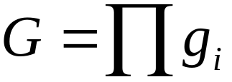
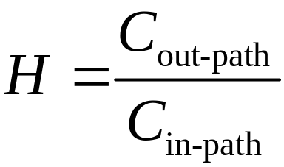
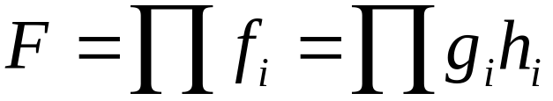
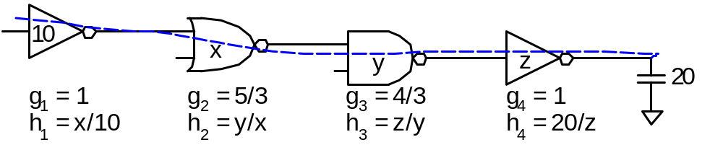
Multistage Logic Networks
Logical effort generalizes to multistage networks
Path Logical Effort
Path Electrical Effort
Path Effort

Slide 21
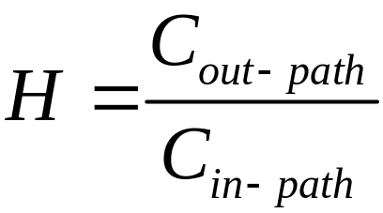
Multistage Logic Networks
Logical effort generalizes to multistage networks
Path Logical Effort
Path Electrical Effort
Path Effort
Can we write F = GH?

Slide 22
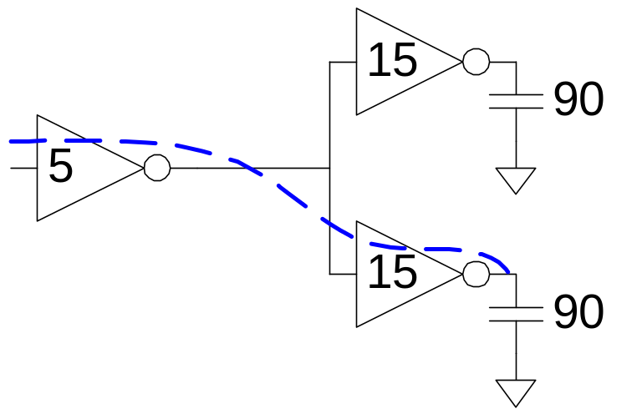
Paths That Branch
No! Consider paths that branch:
G =
H =
GH =
h₁ =
h₂ =
F = GH?

Slide 23
Paths That Branch
No! Consider paths that branch:
G = 1
H = 90 / 5 = 18
GH = 18
h₁ = (15 +15) / 5 = 6
h₂ = 90 / 15 = 6
F = g₁g₂h₁h₂ = 36 = 2GH

Slide 24
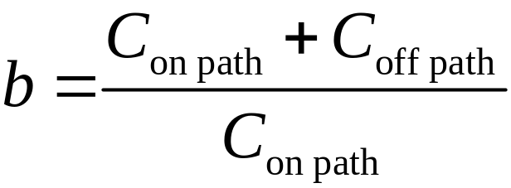
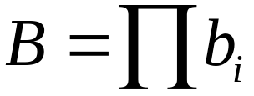

Branching Effort
Introduce branching effort
  Accounts for branching between stages in path
Now we compute the path effort
  F = GBH
Note:

Slide 25
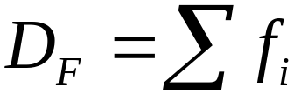
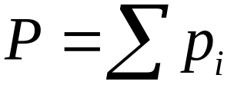
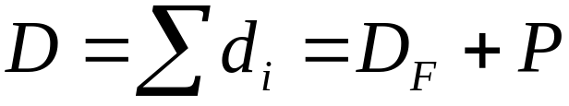
Multistage Delays
Path Effort Delay
Path Parasitic Delay
Path Delay

Slide 26
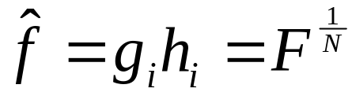

Designing Fast Circuits
Delay is smallest when each stage bears same effort
Thus minimum delay of N stage path is
This is a key result of logical effort
  Find fastest possible delay
  Doesn’t require calculating gate sizes

Slide 27
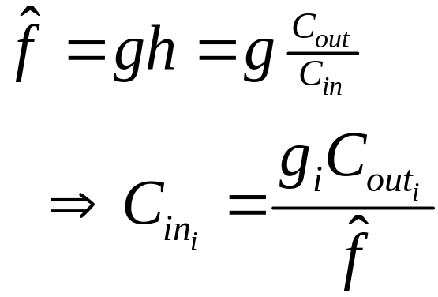
Gate Sizes
How wide should the gates be for least delay?
Working backward, apply capacitance transformation to find input capacitance of each gate given load it drives.
Check work by verifying input cap spec is met.

Slide 28
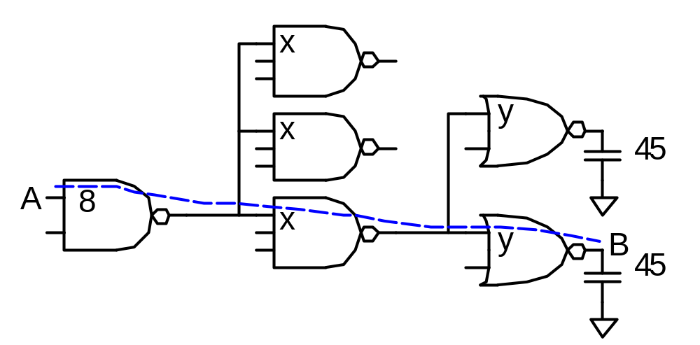
Example: 3-Stage Path
Select gate sizes x and y for least delay from A to B

Slide 29
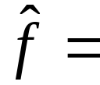
Example: 3-Stage Path
Logical Effort G =
Electrical Effort H =
Branching Effort B =
Path Effort F =
Best Stage Effort
Parasitic Delay P =
Delay D =

Slide 30
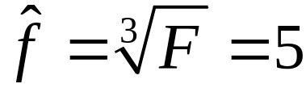
Example: 3-Stage Path
Logical Effort G = (4/3)*(5/3)*(5/3) = 100/27
Electrical Effort H = 45/8
Branching Effort B = 3 * 2 = 6
Path Effort F = GBH = 125
Best Stage Effort
Parasitic Delay P = 2 + 3 + 2 = 7
Delay D = 3*5 + 7 = 22 = 4.4 FO4

Slide 31
Example: 3-Stage Path
Work backward for sizes
y =
x =

Slide 32
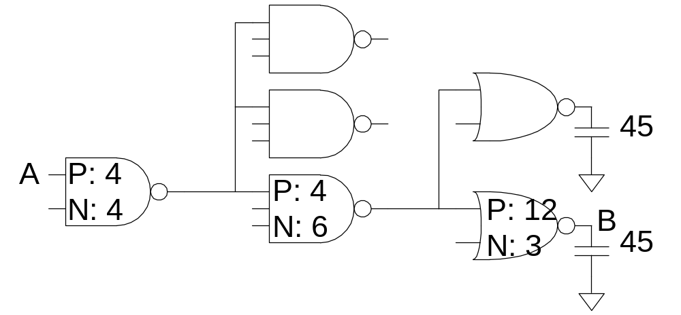
Example: 3-Stage Path
Work backward for sizes
y = 45 * (5/3) / 5 = 15
x = (15*2) * (5/3) / 5 = 10

Slide 33
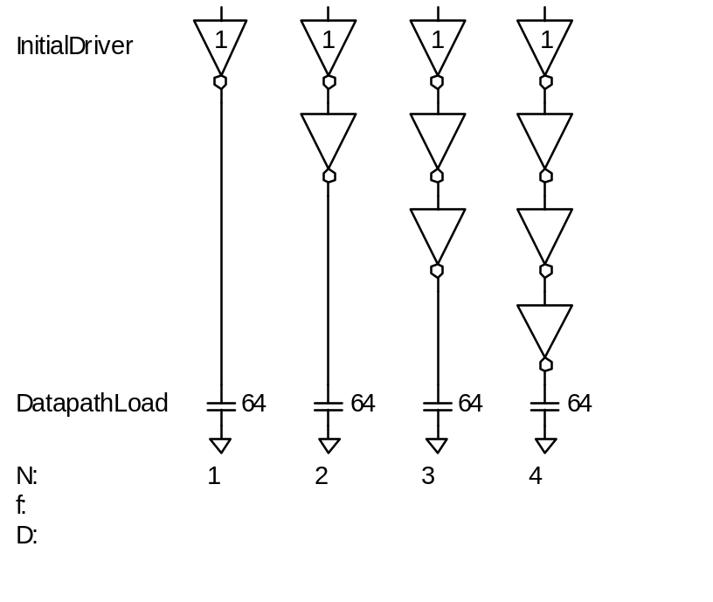
Best Number of Stages
How many stages should a path use?
  Minimizing number of stages is not always fastest
Example: drive 64-bit datapath with unit inverter
D =

Slide 34
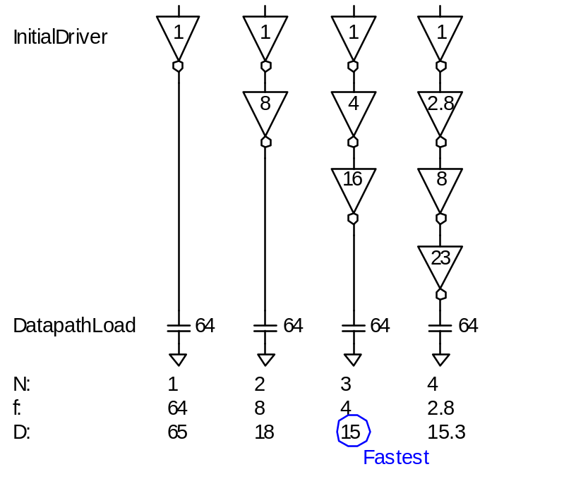
Best Number of Stages
How many stages should a path use?
  Minimizing number of stages is not always fastest
Example: drive 64-bit datapath with unit inverter
D = NF^{1/N} + P
= N(64)^{1/N} + N

Slide 35
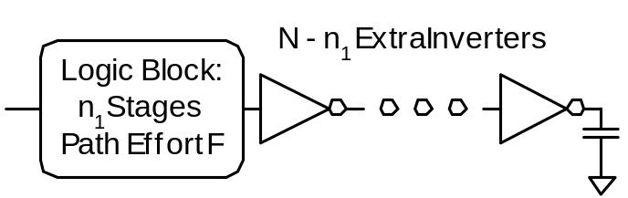
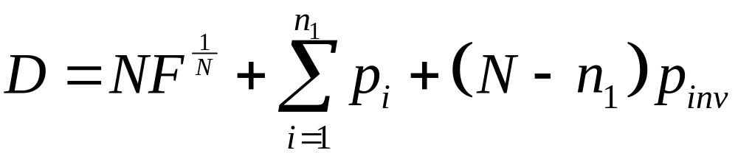
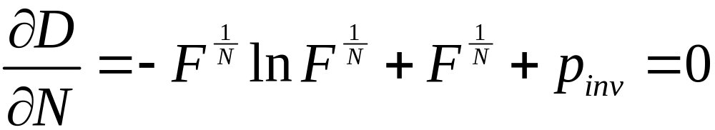
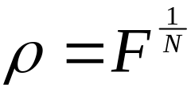
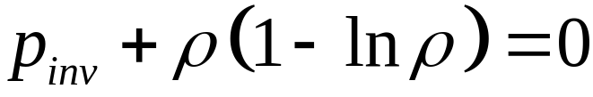
Derivation
Consider adding inverters to end of path
  How many give least delay?
Define best stage effort

Slide 36
Best Stage Effort
has no closed-form solution
Neglecting parasitics (p_{inv} = 0), we find ρ = 2.718 (e)
For p_{inv} = 1, solve numerically for ρ = 3.59

Slide 37
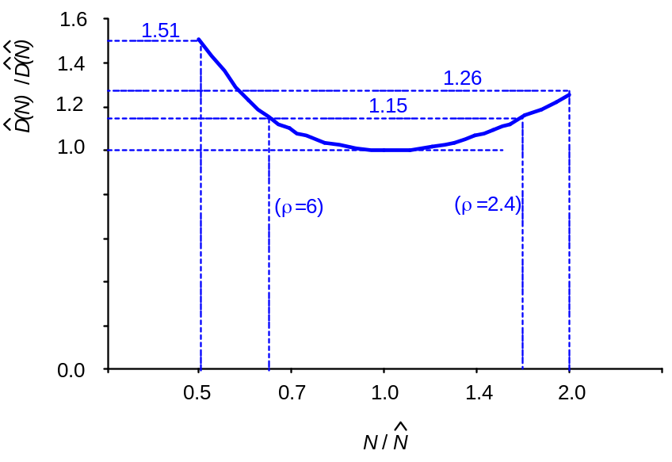
Sensitivity Analysis
How sensitive is delay to using exactly the best number of stages?
2.4 < ρ < 6 gives delay within 15% of optimal
  We can be sloppy!
  I like ρ = 4

Slide 38
Example, Revisited
Ben Bitdiddle is the memory designer for the Motoroil 68W86, an embedded automotive processor. Help Ben design the decoder for a register file.
Decoder specifications:
  16 word register file
  Each word is 32 bits wide
  Each bit presents load of 3 unit-sized transistors
  True and complementary address inputs A[3:0]
  Each input may drive 10 unit-sized transistors
Ben needs to decide:
  How many stages to use?
  How large should each gate be?
  How fast can decoder operate?

Slide 39
Number of Stages
Decoder effort is mainly electrical and branching
Electrical Effort: H =
Branching Effort: B =
If we neglect logical effort (assume G = 1)
Path Effort: F =
Number of Stages: N =

Slide 40
Number of Stages
Decoder effort is mainly electrical and branching
Electrical Effort: H = (32*3) / 10 = 9.6
Branching Effort: B = 8
If we neglect logical effort (assume G = 1)
Path Effort: F = GBH = 76.8
Number of Stages: N = log₄F = 3.1
Try a 3-stage design

Slide 41

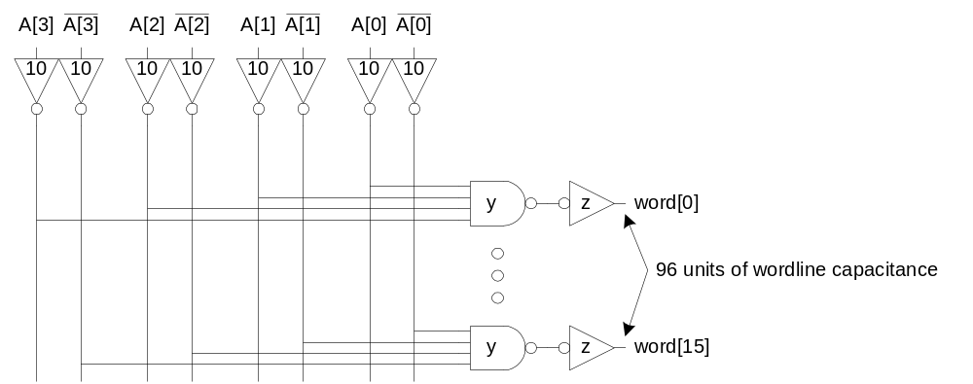
Gate Sizes & Delay
Logical Effort: G =
Path Effort: F =
Stage Effort:
Path Delay:
Gate sizes: z = y =

Slide 42
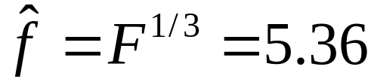
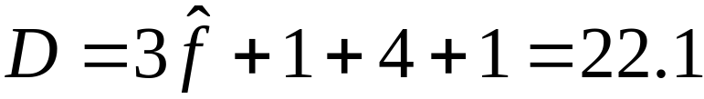
Gate Sizes & Delay
Logical Effort: G = 1 * 6/3 * 1 = 2
Path Effort: F = GBH = 154
Stage Effort:
Path Delay:
Gate sizes: z = 96*1/5.36 = 18 y = 18*2/5.36 = 6.7

Slide 43
Comparison
Compare many alternatives with a spreadsheet
Design | N | G | P | D
NAND4-INV | 2 | 2 | 5 | 29.8
NAND2-NOR2 | 2 | 20/9 | 4 | 30.1
INV-NAND4-INV | 3 | 2 | 6 | 22.1
NAND4-INV-INV-INV | 4 | 2 | 7 | 21.1
NAND2-NOR2-INV-INV | 4 | 20/9 | 6 | 20.5
NAND2-INV-NAND2-INV | 4 | 16/9 | 6 | 19.7
INV-NAND2-INV-NAND2-INV | 5 | 16/9 | 7 | 20.4
NAND2-INV-NAND2-INV-INV-INV | 6 | 16/9 | 8 | 21.6

Slide 44















Review of Definitions
Term | Stage | Path
number of stages
logical effort
electrical effort
branching effort
effort
effort delay
parasitic delay
delay

Slide 45




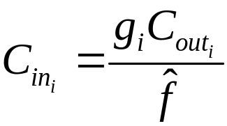
Method of Logical Effort
Compute path effort
Estimate best number of stages
Sketch path with N stages
Estimate least delay
Determine best stage effort
Find gate sizes

Slide 46
Limits of Logical Effort
Chicken and egg problem
  Need path to compute G
  But don’t know number of stages without G
Simplistic delay model
  Neglects input rise time effects
Interconnect
  Iteration required in designs with wire
Maximum speed only
  Not minimum area/power for constrained delay

Slide 47
Summary
Logical effort is useful for thinking of delay in circuits
  Numeric logical effort characterizes gates
  NANDs are faster than NORs in CMOS
  Paths are fastest when effort delays are ~4
  Path delay is weakly sensitive to stages, sizes
  But using fewer stages doesn’t mean faster paths
  Delay of path is about log₄F FO4 inverter delays
  Inverters and NAND2 best for driving large caps
Provides language for discussing fast circuits
  But requires practice to master

